Slide 1


Attique Ahmed
30/10/22

Slide 2

Outline
Executive Summary
Introduction
Methodology
Results
Conclusion
Appendix

Slide 3

Executive Summary
Summary of methodologies
Data collection and wrangling
Exploration Data Analysis with Data Visualization and SQL
Building an interactive map with folium
Building a dashboard with Plotly Dash
Classification
Summary of all results
Data analysis result
Predictive analysis result

Slide 4

Introduction
Project background and context
SpaceX is the most successful company of the commercial space and it makes space travel affordable. It advertises Falcon 9 on website, with a cost of 62 million dollars. Based on public information and machine learning models, we are going to predict if spaceX will reuses the first stage.
Problems you want to find answers
How variables such as payload mass, launch site, number of flights, and orbits affect the success of the first stage landing
Will the rate of successful landings increase in the future
Finding the best algorithm that can be used for binary classification in this case

Slide 5

Section 1

Slide 6

Methodology
Data collection methodology:
By the use of SpaceX Rest API
By the use of Web Scrapping from Wikipedia
Perform data wrangling
Data filtering
Dealing with missing values
One hot encoding to prepare the data to a binary classification
Perform exploratory data analysis (EDA) using visualization and SQL
Perform interactive visual analytics using Folium and Plotly Dash
Perform predictive analysis using classification models
Constructing, tuning, and evaluating classification model to ensure the best results

Slide 7
Data Collection
Describe how data sets were collected.
By the use of SpaceX Rest API
By the use of Web Scrapping from Wikipedia

Slide 8

Data Collection – SpaceX API
Decode the response usinfg .json and .json_normalize
Request iformation by custom functions
Construct dictionary out of data
Requesting rocket launch
Requesting rocket launch
https://github.com/AttiqueAhmed/IBM-capstone/blob/main/week%20data.ipynb
Filter to include only Falcon ( launches
Creating data frame from the dictionary
Export data to CSV
Replacing missing values with mean

Slide 9
Data Collection - Scraping
Requesting Falcon 9 launch data from wikipedia
create BeautifulSoup object from HTML response
Extract all columns names
Requesting rocket launch
https://github.com/AttiqueAhmed/IBM-capstone/blob/main/week%201%20data%20collection%20web%20scapping.ipynb
Collect data by parsing HTML tables
Export data to CSV
Create dataframe from dictionary
Construct data we have obtained into ditionary
9

Slide 10
Data Wrangling
Describe how data were processed
Exploratory data analysis performed.
Then summaries were calculated for launches per site, occurrence of each orbit, and mission outcome per orbit
Lastly, landing outcome label was created
EDA
Summarization
Add landing outcome label
https://github.com/AttiqueAhmed/IBM-capstone/blob/main/week%201%20data%20collection%20web%20scapping.ipynb

Slide 11

EDA with Data Visualization
Different charts are ploted
Flight Number Vs Payload Mass
Flight Number Vs Launch sites
Flight Number Vs Orbit Type
Payload Mass Vs launch site
Payload Mass Vs Orbit Type
And many more
https://github.com/AttiqueAhmed/IBM-capstone/blob/main/week2lab1.ipynb

Slide 12
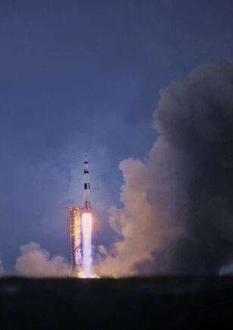
EDA with SQL
Many SQL queries were performed:
Names of the unique launch sites
Launch sites begin with CCA
Total payload mass carried by boosters of NASA
Total payload mass carried by boosters of F9
Date of successful landings
Number of succesful and fail missions
https://github.com/AttiqueAhmed/IBM-capstone/blob/main/week2lab2.ipynb

Slide 13

Build an Interactive Map with Folium
Markers for launch sites using latitude and longitude coordinates:
Circular markers
Popup label
Text label
Colourful markers for the launch outcome for each launch site
Distance between a launch sites.
https://github.com/AttiqueAhmed/IBM-capstone/blob/main/week3.ipynb

Slide 14
Build a Dashboard with Plotly Dash
A dropdown list to enable launch site selection
Pie chart showing successful launches
Slider for payload mass range and selection
Scatter chart of payload mass vs. Success rate
https://github.com/AttiqueAhmed/IBM-capstone/blob/main/week3.ipynb

Slide 15
Predictive Analysis (Classification)
Create a array of the column "Class" from data
data standardization
Train-test split
Creating GridsearchCV object to find best parameters
https://github.com/AttiqueAhmed/IBM-capstone/blob/main/week4%20lab.ipynb
Finding the best model by studying jaccard_score and F!_score
GridsearchCV on different models
Examining confusion matrix
Calculating accuracy

Slide 16

Results
Exploratory data analysis results
Interactive analytics demo in screenshots
Predictive analysis results

Slide 17

Section 2

Slide 18
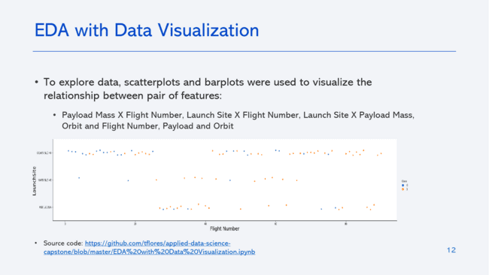
Flight Number vs. Launch Site
Earliest flights failed
VAFB SLC 40 and KSC LC 39A have high success rate

Slide 19
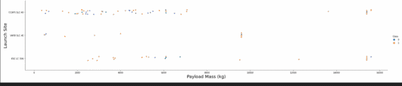
Payload vs. Launch Site
Higher payload mass, higher the success
All launches for KSC LC 39A has been successful for the payload mass under 5500 kg also.

Slide 20
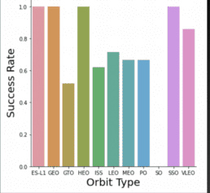
Success Rate vs. Orbit Type
ES-L1, GEO, HEO, SSO orbits are with 100% success
SO no success
GTO, ISS, LEO, MEO, PO with success between 50 to 80 percent

Slide 21
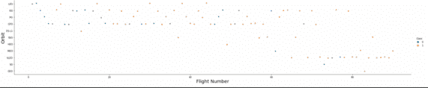
Flight Number vs. Orbit Type
Success relates to the number of flights for LEO orbits,

Slide 22
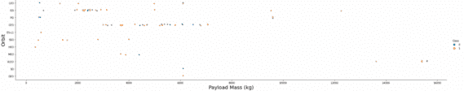
Payload vs. Orbit Type
Heavy payloads negatively impact GTO orbit and positively on GTO and Polar LEO ISS orbits

Slide 23
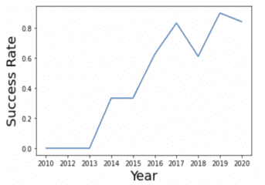
Launch Success Yearly Trend
Success rate since 2013 kept increasing

Slide 24
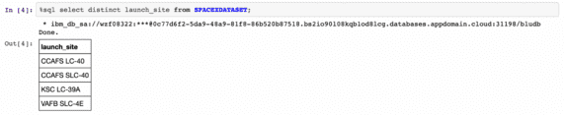
All Launch Site Names
Displayed are the unique launch sites

Slide 25
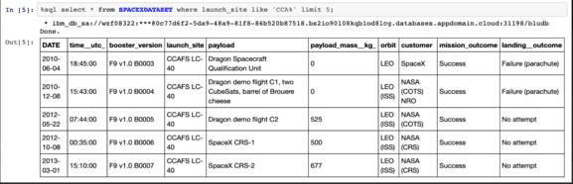
Launch Site Names Begin with 'CCA'
5 launch sites starting the name with "CCA"

Slide 26
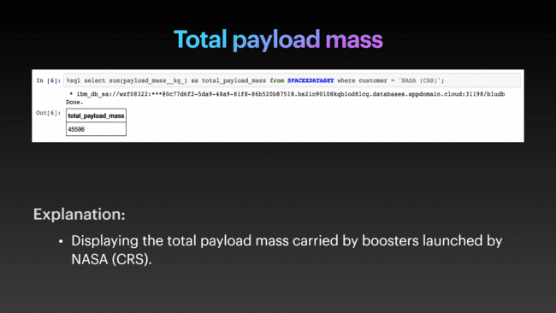
Total Payload Mass
Total mass carried by boosters of NASA CRS

Slide 27
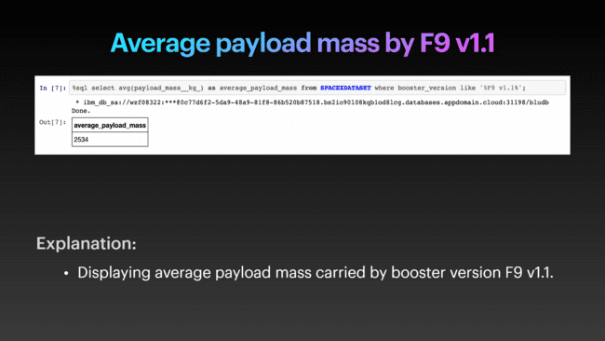
Average Payload Mass by F9 v1.1
Average payload mass carried by bosster version F(9 v1.1

Slide 28
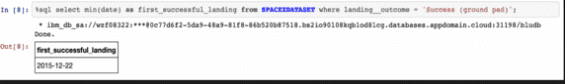
First Successful Ground Landing Date
Date of the first successful landing outcome in ground was achieved

Slide 29
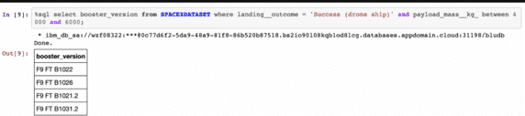
Successful Drone Ship Landing with Payload between 4000 and 6000
Boosters which were successful in drop ship and had payload mass greater than 4000 but less than 6000

Slide 30
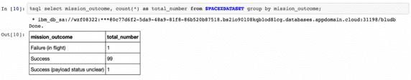
Total Number of Successful and Failure Mission Outcomes
Total number of successful and failure mission

Slide 31
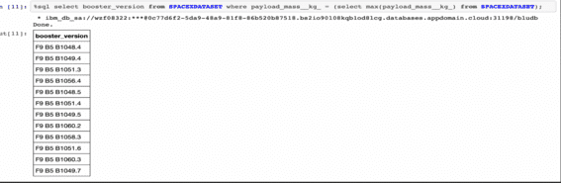
Boosters Carried Maximum Payload
List of the boosters which carried maximum payload mass

Slide 32
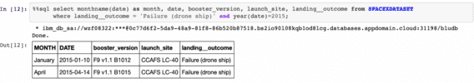
2015 Launch Records
List of failed landing in drone ship, their booster versions and launch sites for the year 2015

Slide 33
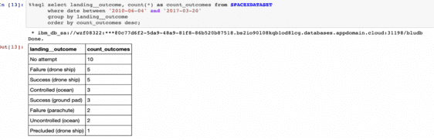
Rank Landing Outcomes Between 2010-06-04 and 2017-03-20
Rank of the count of failed and success landing outcomesbetween 4/6/2010 to 20/3/2017 in descending order

Slide 34

Section 3

Slide 35
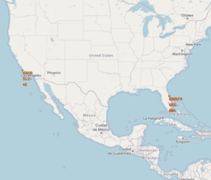
Launch sites are marked on global map
Launches are in proximity to the equator line. because earth moves faster near equator line so, this movement help rockets to orbit around earth once launched. Moreover, all sites are near ocean for the safety purposes.

Slide 36
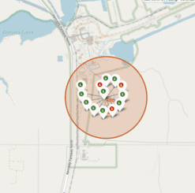
Color-labels launch sites on global map
Colour label indentifies which launch sites have relatively high success rates.
Green is for successful and red for failed.

Slide 37
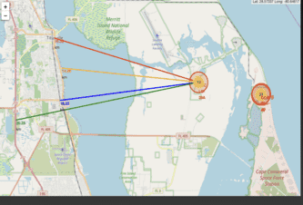
<Folium Map Screenshot 3>
We can see that KSC LC-39A is relatively closer to railway, highway, coastline
But, this is closer to city and it can be dangerous also

Slide 38

Section 4

Slide 39
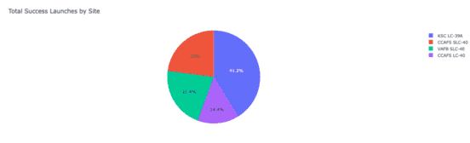
Successful launch for all sies
Chart shows thatKSC LC-39A has the most successful launches

Slide 40
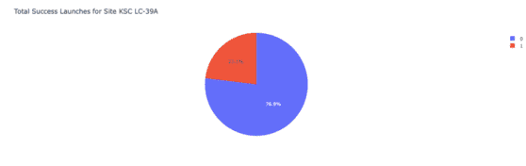
Launch site with highest launch successful
KSC LC-39A has highest launch successful of 76.9 percent for 13 launches.

Slide 41
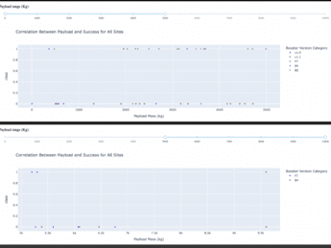
Payload mass vs. Launch outcome
Chart shows that payload between 2000 and 5500 kg have the highest success rate.

Slide 42

Section 5

Slide 43
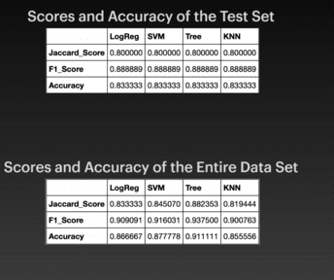
Classification Accuracy

Slide 44
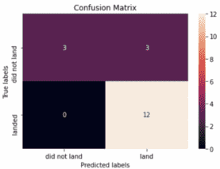
Confusion Matrix
Major problem is false positive

Slide 45
Conclusions
Decision Tree Model is the best.
Launches with a low payload mass show better results than larger mass
Launch site are near to equator line and coast.
Success rate increase over years
KSC LC-39-A has the highest success rate
Orbits ES-L1, GEO, HEO and SSO have 100% success rate

Slide 46
https://github.com/AttiqueAhmed/python-project-for-data-science-course-final-assignment
Thanks to:
Python Tutorials – Real Python
Appendix

Slide 47


